Slide 1

Conditional Access Framework for Zero Trust
Philipp Kohn – 11.08.2023

Slide 2

Agenda
Introduction
CA Personas
Template Access Cards
Policies per Persona in Detail

Slide 3

Introduction
Welcome to this presentation on Conditional Access Framework for Zero Trust by Claus Jespersen.
I am Philipp Kohn, a german Microsoft 365 Consultant.
In this presentation, I will explain how to use the Conditional Access Framework for Zero Trust to design and implement policies that cover different personas and use cases.

Slide 4
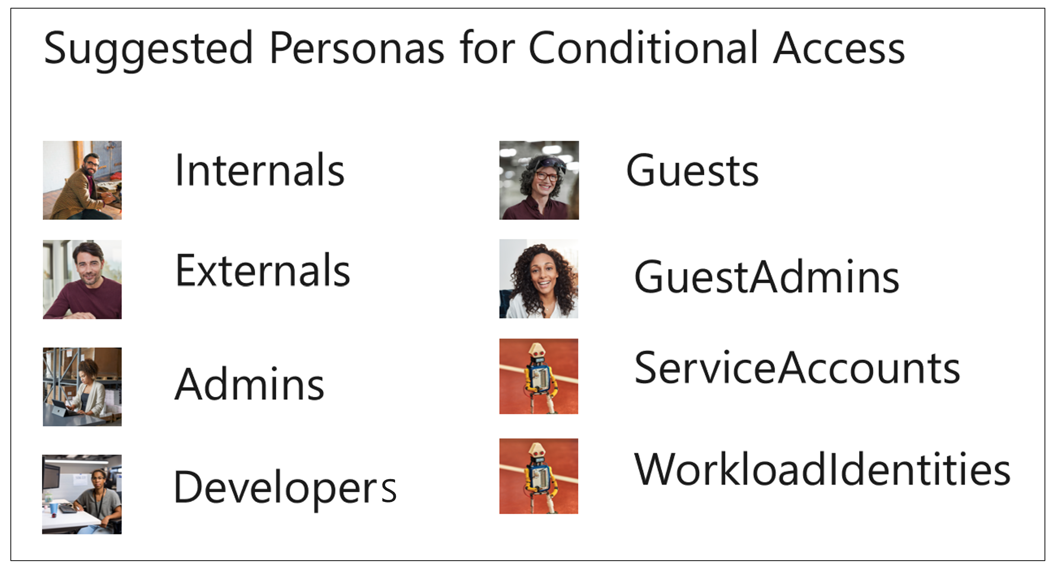
Conditional Access Personas
(click the Persona)
ℹ️ Persona Externals and Developers are not part of this presentation

Slide 5
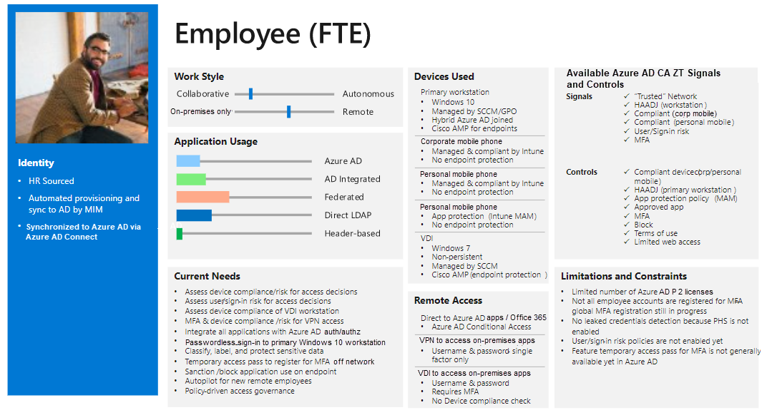
Example – Template Access Card

Slide 6


Conditional Access Policy Documentation
Tenant ID
e8d58456-3546-4289-b2a2-b9ac3a1eca0f
Tenant Name
Contoso
Generated by
Megan Bowen (MeganB@M365x77476191.OnMicrosoft.com)
Generated on
11 Aug 2023
idPowerToys.com

Slide 7

Persona: Global
This persona includes all users in the organization.
It is used to apply baseline policies that cover all users and all apps.

Slide 8
























CA001-Global-BaseProtection-AllApps-AnyPlatform-BlockNonPersonas
Policy Enabled
Last modified: 2023-08-10
Risk
Device platforms
Client apps
Filter for devices
Locations
Not configured
Not configured
Not configured
Not configured
Not configured
Conditions
Users
Block access
All cloud apps
Grant Controls
Session Controls
✅ Include:
Users
- All
🚫 Exclude:
Guest or external users
All external Azure AD organizations
Groups
- CA-BreakGlassAccounts (1)
- CA-Persona-Internals (1)
- CA-Persona-Admins (1)
- CA-Persona-Externals (0)
- CA-Persona-AzureServiceAccounts (0)
- CA-Persona-GuestAdmins (0)
- CA-Persona-Microsoft365ServiceAccounts (0)
- CA-Persona-Global-Exclusions (0)
Multifactor authentication
✅ Include:
- All
App enforced restrictions
Authentication strength
Conditional Access App Control
App Control Policy
Compliant device
Sign-in frequency
Hybrid Azure AD joined device
Periodic reauthentication
Approved client app
Persistent browser session
Always persistent
App protection policy
Continuous access evaluation
Strictly enforce location policies
Change password
Disable resilience defaults
Custom authentication factor
Token protection for session
Terms of use

Slide 9

CA002-Global-AttackSurfaceReduction-VariousApps-AnyPlatform-Block
Policy Enabled
Last modified: 2023-07-10
Risk
Device platforms
Client apps
Filter for devices
Locations
Not configured
Not configured
Not configured
Not configured
Not configured
Conditions
Users
Block access
Selected cloud apps
Grant Controls
Session Controls
✅ Include:
Users
- All
🚫 Exclude:
Groups
- CA-BreakGlassAccounts (1)
- CA-Persona-Global-Exclusions (0)
Multifactor authentication
✅ Include:
- Yammer
- Sway
App enforced restrictions
Authentication strength
Conditional Access App Control
App Control Policy
Compliant device
Sign-in frequency
Hybrid Azure AD joined device
Periodic reauthentication
Approved client app
Persistent browser session
Always persistent
App protection policy
Continuous access evaluation
Strictly enforce location policies
Change password
Disable resilience defaults
Custom authentication factor
Token protection for session
Terms of use

Slide 10
CA003-Global-AttackSurfaceReduction-AllApps-AnyPlatform-BlockGeoIP
Policy Enabled
Last modified: 2023-08-10
Risk
Device platforms
Client apps
Filter for devices
Locations
Not configured
Not configured
Not configured
Not configured
✅ Include
- CA-Blocked-Countries-ByIPv4andIPv6
Conditions
Users
Block access
All cloud apps
Grant Controls
Session Controls
✅ Include:
Users
- All
🚫 Exclude:
Groups
- CA-BreakGlassAccounts (1)
- CA-Persona-Global-Exclusions (0)
Multifactor authentication
✅ Include:
- All
App enforced restrictions
Authentication strength
Conditional Access App Control
App Control Policy
Compliant device
Sign-in frequency
Hybrid Azure AD joined device
Periodic reauthentication
Approved client app
Persistent browser session
Always persistent
App protection policy
Continuous access evaluation
Strictly enforce location policies
Change password
Disable resilience defaults
Custom authentication factor
Token protection for session
Terms of use

Slide 11


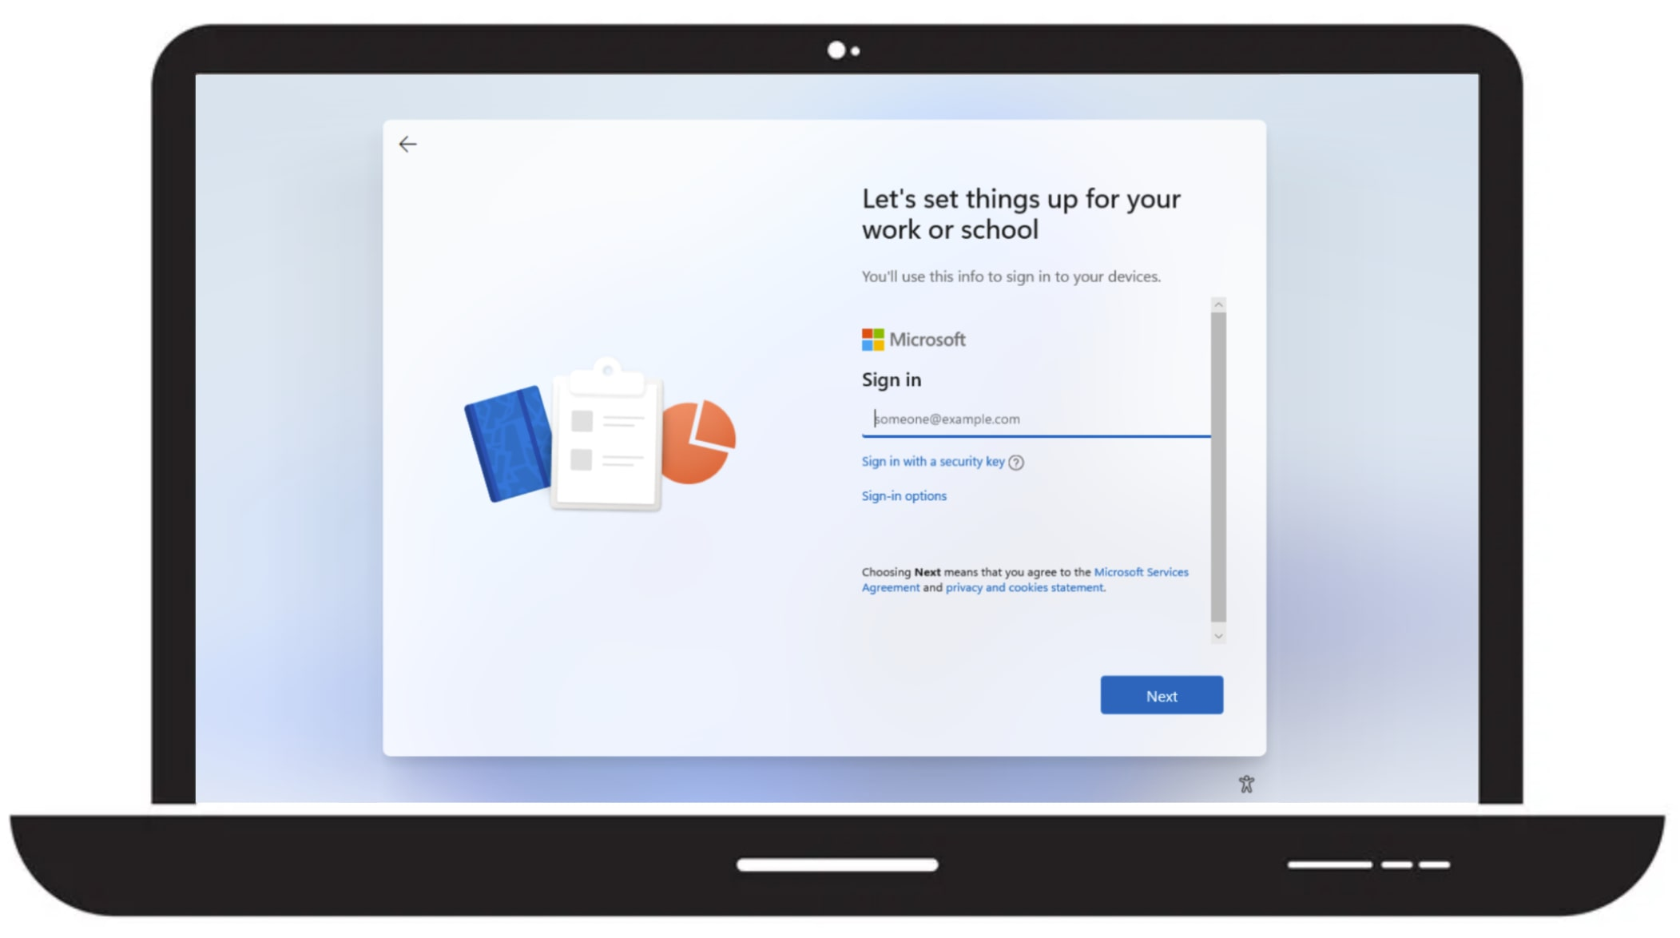
CA004-Global-BaseProtection-AllApps-AnyPlatform-MFAforDeviceRegistration
Policy Enabled
Last modified: 2023-07-13
Risk
Device platforms
Client apps
Filter for devices
Locations
Not configured
Not configured
Not configured
Not configured
✅ Include
- All
🚫 Exclude
- CompanyHQInternetBreakout
Conditions
Users
Grant access
Register or join devices
Grant Controls
Session Controls
✅ Include:
Users
- All
🚫 Exclude:
Groups
- CA-BreakGlassAccounts (1)
- CA-Persona-Global-Exclusions (0)
Multifactor authentication
App enforced restrictions
Authentication strength
Conditional Access App Control
App Control Policy
Compliant device
Sign-in frequency
Hybrid Azure AD joined device
Periodic reauthentication
Approved client app
Persistent browser session
Always persistent
App protection policy
Continuous access evaluation
Strictly enforce location policies
Change password
Disable resilience defaults
Custom authentication factor
Token protection for session
Terms of use

Slide 12
Persona: Admins
This persona includes users who have administrative privileges, such as global administrators, security administrators, or application administrators.
It is used to apply stricter policies that protect sensitive resources and actions.

Slide 13
CA100-Admins-BaseProtection-AllApps-AnyPlatform-CompliantorHybridJoin
Policy Enabled
Last modified: 2023-08-10
Risk
Device platforms
Client apps
Filter for devices
Locations
Not configured
Not configured
Not configured
Not configured
Not configured
Conditions
Users
Grant access
All cloud apps
Require ONE
Session Controls
Grant Controls
✅ Include:
Groups
- CA-Persona-Admins (1)
🚫 Exclude:
Groups
- CA-BreakGlassAccounts (1)
- CA-Persona-Admins-Exclusions (0)
Multifactor authentication
✅ Include:
- All
🚫 Exclude:
- Microsoft Intune Enrollment
App enforced restrictions
Authentication strength
Conditional Access App Control
App Control Policy
Compliant device
Sign-in frequency
Hybrid Azure AD joined device
Periodic reauthentication
Approved client app
Persistent browser session
Always persistent
App protection policy
Continuous access evaluation
Strictly enforce location policies
Change password
Disable resilience defaults
Custom authentication factor
Token protection for session
Terms of use

Slide 14
CA101-Admins-BaseProtection-AllApps-AnyPlatform-MFA
Policy Enabled
Last modified: 2023-08-10
Risk
Device platforms
Client apps
Filter for devices
Locations
Not configured
Not configured
Not configured
Not configured
Not configured
Conditions
Users
Grant access
All cloud apps
Grant Controls
Session Controls
✅ Include:
Groups
- CA-Persona-Admins (1)
🚫 Exclude:
Groups
- CA-BreakGlassAccounts (1)
- CA-Persona-Admins-Exclusions (0)
Multifactor authentication
✅ Include:
- All
App enforced restrictions
Authentication strength
Conditional Access App Control
App Control Policy
Compliant device
Sign-in frequency
Hybrid Azure AD joined device
Periodic reauthentication
Approved client app
Persistent browser session
Always persistent
App protection policy
Continuous access evaluation
Strictly enforce location policies
Change password
Disable resilience defaults
Custom authentication factor
Token protection for session
Terms of use

Slide 15

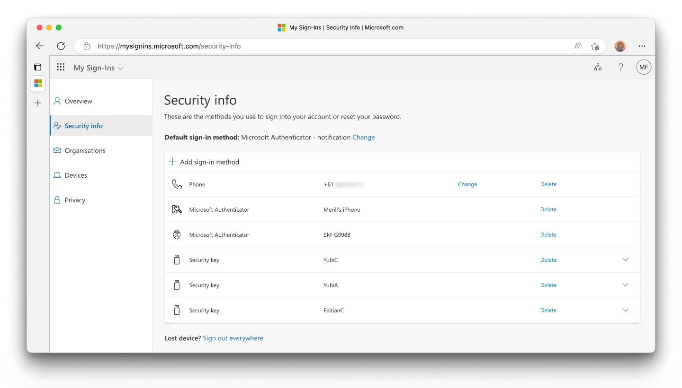
CA102-Admins-IdentityProtection-AllApps-AnyPlatform-CombinedRegistration
Policy Enabled
Last modified: 2023-08-10
Risk
Device platforms
Client apps
Filter for devices
Locations
Not configured
Not configured
Not configured
Not configured
Not configured
Conditions
Users
Grant access
Register security information
Require ONE
Session Controls
Grant Controls
✅ Include:
Groups
- CA-Persona-Admins (1)
🚫 Exclude:
Groups
- CA-BreakGlassAccounts (1)
- CA-Persona-Admins-Exclusions (0)
Multifactor authentication
App enforced restrictions
Authentication strength
Conditional Access App Control
App Control Policy
Compliant device
Sign-in frequency
Hybrid Azure AD joined device
Periodic reauthentication
Approved client app
Persistent browser session
Always persistent
App protection policy
Continuous access evaluation
Strictly enforce location policies
Change password
Disable resilience defaults
Custom authentication factor
Token protection for session
Terms of use

Slide 16
CA103-Admins-IdentityProtection-AllApps-AnyPlatform-MFAandPWDforMediumandHighUserRisk
Policy Disabled
Last modified: 2023-08-10
Risk
Device platforms
Client apps
Filter for devices
Locations
User risk risk:
- High
- Medium
Not configured
Not configured
Not configured
Not configured
Conditions
Users
Grant access
All cloud apps
Require ALL
Session Controls
Grant Controls
✅ Include:
Groups
- CA-Persona-Admins (1)
🚫 Exclude:
Groups
- CA-BreakGlassAccounts (1)
- CA-Persona-Admins-Exclusions (0)
Multifactor authentication
✅ Include:
- All
App enforced restrictions
Authentication strength
Conditional Access App Control
App Control Policy
Compliant device
Sign-in frequency
Hybrid Azure AD joined device
Periodic reauthentication
Approved client app
Persistent browser session
Always persistent
App protection policy
Continuous access evaluation
Strictly enforce location policies
Change password
Disable resilience defaults
Custom authentication factor
Token protection for session
Terms of use

Slide 17
CA105-Admins-IdentityProtection-AllApps-AnyPlatform-BlockLegacyAuth
Policy Enabled
Last modified: 2023-08-10
Risk
Device platforms
Client apps
Filter for devices
Locations
Not configured
Not configured
- Exchange ActiveSync clients
- Other legacy clients
Not configured
Not configured
Conditions
Users
Block access
All cloud apps
Grant Controls
Session Controls
✅ Include:
Groups
- CA-Persona-Admins (1)
🚫 Exclude:
Groups
- CA-BreakGlassAccounts (1)
- CA-Persona-Admins-Exclusions (0)
Multifactor authentication
✅ Include:
- All
App enforced restrictions
Authentication strength
Conditional Access App Control
App Control Policy
Compliant device
Sign-in frequency
Hybrid Azure AD joined device
Periodic reauthentication
Approved client app
Persistent browser session
Always persistent
App protection policy
Continuous access evaluation
Strictly enforce location policies
Change password
Disable resilience defaults
Custom authentication factor
Token protection for session
Terms of use

Slide 18
CA106-Admins-AppProtection-MicrosoftIntuneEnrollment-AnyPlatform-MFA
Policy Enabled
Last modified: 2023-08-10
Risk
Device platforms
Client apps
Filter for devices
Locations
Not configured
Not configured
Not configured
Not configured
Not configured
Conditions
Users
Grant access
Selected cloud apps
Grant Controls
Session Controls
✅ Include:
Groups
- CA-Persona-Admins (1)
🚫 Exclude:
Groups
- CA-BreakGlassAccounts (1)
- CA-Persona-Admins-Exclusions (0)
Multifactor authentication
✅ Include:
- Microsoft Intune Enrollment
App enforced restrictions
Authentication strength
Conditional Access App Control
App Control Policy
Compliant device
Sign-in frequency
Hybrid Azure AD joined device
Periodic reauthentication
Approved client app
Persistent browser session
Always persistent
App protection policy
Continuous access evaluation
Strictly enforce location policies
Change password
Disable resilience defaults
Custom authentication factor
Token protection for session
Terms of use

Slide 19
CA107-Admins-DataandAppProtection-AllApps-iOSorAndroid-AppProtectionPolicy
Policy Disabled
Last modified: 2023-08-10
Risk
Device platforms
Client apps
Filter for devices
Locations
Not configured
✅ Include
- 📱Android
- 📱 iOS
Not configured
Not configured
Not configured
Conditions
Users
Grant access
All cloud apps
Grant Controls
Session Controls
✅ Include:
Groups
- CA-Persona-Admins (1)
🚫 Exclude:
Groups
- CA-BreakGlassAccounts (1)
- CA-Persona-Admins-Exclusions (0)
Multifactor authentication
✅ Include:
- All
🚫 Exclude:
- Microsoft Intune Enrollment
App enforced restrictions
Authentication strength
Conditional Access App Control
App Control Policy
Compliant device
Sign-in frequency
Hybrid Azure AD joined device
Periodic reauthentication
Approved client app
Persistent browser session
Always persistent
App protection policy
Continuous access evaluation
Strictly enforce location policies
Change password
Disable resilience defaults
Custom authentication factor
Token protection for session
Terms of use

Slide 20
CA108-Admins-DataProtection-AllApps-AnyPlatform-SessionPolicy
Policy Enabled
Last modified: 2023-08-10
Risk
Device platforms
Client apps
Filter for devices
Locations
Not configured
Not configured
Not configured
Exclude when
device.extensionAttribute1 -eq "CONTOSO-IT"
Not configured
Conditions
Users
Grant access
All cloud apps
Grant Controls
Session Controls
✅ Include:
Groups
- CA-Persona-Admins (1)
🚫 Exclude:
Groups
- CA-BreakGlassAccounts (1)
- CA-Persona-Admins-Exclusions (0)
Multifactor authentication
✅ Include:
- All
App enforced restrictions
Authentication strength
Conditional Access App Control
App Control Policy
Compliant device
Sign-in frequency
Hybrid Azure AD joined device
1 hour
Approved client app
Persistent browser session
Never persistent
App protection policy
Continuous access evaluation
Strictly enforce location policies
Change password
Disable resilience defaults
Custom authentication factor
Token protection for session
Terms of use

Slide 21
CA109-Admins-AttackSurfaceReduction-AllApps-AnyPlatform-BlockUnwantedPlatforms
Policy Enabled
Last modified: 2023-08-10
Risk
Device platforms
Client apps
Filter for devices
Locations
Not configured
✅ Include
- All
🚫 Exclude
- 💻 Windows
Not configured
Not configured
Not configured
Conditions
Users
Block access
All cloud apps
Grant Controls
Session Controls
✅ Include:
Groups
- CA-Persona-Admins (1)
🚫 Exclude:
Groups
- CA-BreakGlassAccounts (1)
- CA-Persona-Admins-Exclusions (0)
Multifactor authentication
✅ Include:
- All
App enforced restrictions
Authentication strength
Conditional Access App Control
App Control Policy
Compliant device
Sign-in frequency
Hybrid Azure AD joined device
Periodic reauthentication
Approved client app
Persistent browser session
Always persistent
App protection policy
Continuous access evaluation
Strictly enforce location policies
Change password
Disable resilience defaults
Custom authentication factor
Token protection for session
Terms of use

Slide 22
Persona: Internals
This persona includes users who are employees of the organization and have a corporate identity.
It is used to apply policies that reflect the trust level of the internal users and their devices.

Slide 23
CA200-Internals-BaseProtection-AllApps-AnyPlatform-CompliantorHybridJoin
Policy Enabled
Last modified: 2023-08-10
Risk
Device platforms
Client apps
Filter for devices
Locations
Not configured
Not configured
Not configured
Not configured
Not configured
Conditions
Users
Grant access
All cloud apps
Require ONE
Session Controls
Grant Controls
✅ Include:
Groups
- CA-Persona-Internals (1)
🚫 Exclude:
Groups
- CA-BreakGlassAccounts (1)
- CA-Persona-Internals-Exclusions (0)
Multifactor authentication
✅ Include:
- All
🚫 Exclude:
- Microsoft Intune Enrollment
App enforced restrictions
Authentication strength
Conditional Access App Control
App Control Policy
Compliant device
Sign-in frequency
Hybrid Azure AD joined device
Periodic reauthentication
Approved client app
Persistent browser session
Always persistent
App protection policy
Continuous access evaluation
Strictly enforce location policies
Change password
Disable resilience defaults
Custom authentication factor
Token protection for session
Terms of use

Slide 24
CA201-Internals-IdentityProtection-AllApps-AnyPlatform-CombinedRegistration
Policy Enabled
Last modified: 2023-08-10
Risk
Device platforms
Client apps
Filter for devices
Locations
Not configured
Not configured
Not configured
Not configured
Not configured
Conditions
Users
Grant access
Register security information
Require ONE
Session Controls
Grant Controls
✅ Include:
Groups
- CA-Persona-Internals (1)
🚫 Exclude:
Groups
- CA-BreakGlassAccounts (1)
- CA-Persona-Internals-Exclusions (0)
Multifactor authentication
App enforced restrictions
Authentication strength
Conditional Access App Control
App Control Policy
Compliant device
Sign-in frequency
Hybrid Azure AD joined device
Periodic reauthentication
Approved client app
Persistent browser session
Always persistent
App protection policy
Continuous access evaluation
Strictly enforce location policies
Change password
Disable resilience defaults
Custom authentication factor
Token protection for session
Terms of use

Slide 25
CA204-Internals-IdentityProtection-AllApps-AnyPlatform-BlockLegacyAuth
Policy Enabled
Last modified: 2023-08-10
Risk
Device platforms
Client apps
Filter for devices
Locations
Not configured
Not configured
- Exchange ActiveSync clients
- Other legacy clients
Not configured
Not configured
Conditions
Users
Block access
All cloud apps
Grant Controls
Session Controls
✅ Include:
Groups
- CA-Persona-Internals (1)
🚫 Exclude:
Groups
- CA-BreakGlassAccounts (1)
- CA-Persona-Internals-Exclusions (0)
Multifactor authentication
✅ Include:
- All
App enforced restrictions
Authentication strength
Conditional Access App Control
App Control Policy
Compliant device
Sign-in frequency
Hybrid Azure AD joined device
Periodic reauthentication
Approved client app
Persistent browser session
Always persistent
App protection policy
Continuous access evaluation
Strictly enforce location policies
Change password
Disable resilience defaults
Custom authentication factor
Token protection for session
Terms of use

Slide 26
CA205-Internals-AppProtection-MicrosoftIntuneEnrollment-AnyPlatform-MFA
Policy Enabled
Last modified: 2023-08-10
Risk
Device platforms
Client apps
Filter for devices
Locations
Not configured
Not configured
Not configured
Not configured
Not configured
Conditions
Users
Grant access
Selected cloud apps
Grant Controls
Session Controls
✅ Include:
Groups
- CA-Persona-Internals (1)
🚫 Exclude:
Groups
- CA-BreakGlassAccounts (1)
- CA-Persona-Internals-Exclusions (0)
Multifactor authentication
✅ Include:
- Microsoft Intune Enrollment
App enforced restrictions
Authentication strength
Conditional Access App Control
App Control Policy
Compliant device
Sign-in frequency
Hybrid Azure AD joined device
Periodic reauthentication
Approved client app
Persistent browser session
Always persistent
App protection policy
Continuous access evaluation
Strictly enforce location policies
Change password
Disable resilience defaults
Custom authentication factor
Token protection for session
Terms of use

Slide 27
CA207-Internals-AttackSurfaceReduction-AllApps-AnyPlatform-BlockUnknownPlatforms
Policy Enabled
Last modified: 2023-08-10
Risk
Device platforms
Client apps
Filter for devices
Locations
Not configured
✅ Include
- All
🚫 Exclude
- 📱Android
- 📱 iOS
- 💻 Windows
- 💻 macOS
Not configured
Not configured
Not configured
Conditions
Users
Block access
All cloud apps
Grant Controls
Session Controls
✅ Include:
Groups
- CA-Persona-Internals (1)
🚫 Exclude:
Groups
- CA-BreakGlassAccounts (1)
- CA-Persona-Internals-Exclusions (0)
Multifactor authentication
✅ Include:
- All
App enforced restrictions
Authentication strength
Conditional Access App Control
App Control Policy
Compliant device
Sign-in frequency
Hybrid Azure AD joined device
Periodic reauthentication
Approved client app
Persistent browser session
Always persistent
App protection policy
Continuous access evaluation
Strictly enforce location policies
Change password
Disable resilience defaults
Custom authentication factor
Token protection for session
Terms of use

Slide 28
Persona: GuestUsers
This persona includes users who are invited to collaborate with the organization through Microsoft Entra B2B.
They have an identity that is managed by their own organization or by a consumer identity provider, such as Microsoft, Google, or Facebook.
It is used to apply policies that restrict the access of guest users to only the resources they are invited to.

Slide 29

CA400-Guests-BaseProtection-AllApps-AnyPlatform-MFA
Policy Enabled
Last modified: 2023-08-10
Risk
Device platforms
Client apps
Filter for devices
Locations
Not configured
Not configured
Not configured
Not configured
Not configured
Conditions
Users
Grant access
All cloud apps
Grant Controls
Session Controls
✅ Include:
Guest or external users
All external Azure AD organizations
🚫 Exclude:
Groups
- CA-BreakGlassAccounts (1)
- CA-Persona-Guests-Exclusions (0)
Multifactor authentication
✅ Include:
- All
App enforced restrictions
Authentication strength
Conditional Access App Control
App Control Policy
Compliant device
Sign-in frequency
Hybrid Azure AD joined device
Periodic reauthentication
Approved client app
Persistent browser session
Always persistent
App protection policy
Continuous access evaluation
Strictly enforce location policies
Change password
Disable resilience defaults
Custom authentication factor
Token protection for session
Terms of use

Slide 30
CA401-Guests-IdentityProtection-AllApps-AnyPlatform-TOU-CombinedRegistration
Policy Enabled
Last modified: 2023-08-10
Risk
Device platforms
Client apps
Filter for devices
Locations
Not configured
Not configured
Not configured
Not configured
Not configured
Conditions
Users
Grant access
Register security information
Grant Controls
Session Controls
✅ Include:
Guest or external users
All external Azure AD organizations
🚫 Exclude:
Groups
- CA-BreakGlassAccounts (1)
- CA-Persona-Guests-Exclusions (0)
Multifactor authentication
App enforced restrictions
Authentication strength
Conditional Access App Control
App Control Policy
Compliant device
Sign-in frequency
Hybrid Azure AD joined device
Periodic reauthentication
Approved client app
Persistent browser session
Always persistent
App protection policy
Continuous access evaluation
Strictly enforce location policies
Change password
Disable resilience defaults
Custom authentication factor
Token protection for session
Contoso - Terms of Use - Guests

Slide 31
CA403-Guests-IdentityProtection-AllApps-AnyPlatform-BlockLegacyAuth
Policy Enabled
Last modified: 2023-08-10
Risk
Device platforms
Client apps
Filter for devices
Locations
Not configured
Not configured
- Exchange ActiveSync clients
- Other legacy clients
Not configured
Not configured
Conditions
Users
Block access
All cloud apps
Grant Controls
Session Controls
✅ Include:
Guest or external users
All external Azure AD organizations
🚫 Exclude:
Groups
- CA-BreakGlassAccounts (1)
- CA-Persona-Guests-Exclusions (0)
Multifactor authentication
✅ Include:
- All
App enforced restrictions
Authentication strength
Conditional Access App Control
App Control Policy
Compliant device
Sign-in frequency
Hybrid Azure AD joined device
Periodic reauthentication
Approved client app
Persistent browser session
Always persistent
App protection policy
Continuous access evaluation
Strictly enforce location policies
Change password
Disable resilience defaults
Custom authentication factor
Token protection for session
Terms of use

Slide 32
CA404-Guests-AttackSurfaceReduction-AllApps-AnyPlatform-BlockNonGuestAppAccess
Policy Enabled
Last modified: 2023-08-10
Risk
Device platforms
Client apps
Filter for devices
Locations
Not configured
Not configured
Not configured
Not configured
Not configured
Conditions
Users
Block access
Selected cloud apps
Grant Controls
Session Controls
✅ Include:
Guest or external users
All external Azure AD organizations
🚫 Exclude:
Groups
- CA-BreakGlassAccounts (1)
- CA-Persona-Guests-Exclusions (0)
Multifactor authentication
✅ Include:
- MicrosoftAdminPortals
App enforced restrictions
Authentication strength
Conditional Access App Control
App Control Policy
Compliant device
Sign-in frequency
Hybrid Azure AD joined device
Periodic reauthentication
Approved client app
Persistent browser session
Always persistent
App protection policy
Continuous access evaluation
Strictly enforce location policies
Change password
Disable resilience defaults
Custom authentication factor
Token protection for session
Terms of use

Slide 33
CA405-Guests-ComplianceProtection-AllApps-AnyPlatform-RequireTOU
Policy Enabled
Last modified: 2023-08-10
Risk
Device platforms
Client apps
Filter for devices
Locations
Not configured
Not configured
Not configured
Not configured
Not configured
Conditions
Users
Grant access
All cloud apps
Grant Controls
Session Controls
✅ Include:
Guest or external users
All external Azure AD organizations
🚫 Exclude:
Groups
- CA-BreakGlassAccounts (1)
- CA-Persona-Guests-Exclusions (0)
Multifactor authentication
✅ Include:
- All
App enforced restrictions
Authentication strength
Conditional Access App Control
App Control Policy
Compliant device
Sign-in frequency
Hybrid Azure AD joined device
Periodic reauthentication
Approved client app
Persistent browser session
Always persistent
App protection policy
Continuous access evaluation
Strictly enforce location policies
Change password
Disable resilience defaults
Custom authentication factor
Token protection for session
Contoso - Terms of Use - Guests

Slide 34
Persona: GuestAdmins
This persona includes non-employee users who are granted administrative privileges in the organization.
It is used to apply policies that enforce additional security & compliance measures for guest admins, such as multi-factor authentication and Terms of Use.

Slide 35
CA500-GuestAdmins-BaseProtection-AllApps-AnyPlatform-MFA
Policy Enabled
Last modified: 2023-08-10
Risk
Device platforms
Client apps
Filter for devices
Locations
Not configured
Not configured
Not configured
Not configured
Not configured
Conditions
Users
Grant access
All cloud apps
Grant Controls
Session Controls
✅ Include:
Groups
- CA-Persona-GuestAdmins (0)
🚫 Exclude:
Groups
- CA-BreakGlassAccounts (1)
- CA-Persona-GuestAdmins-Exclusions (0)
Multifactor authentication
✅ Include:
- All
App enforced restrictions
Authentication strength
Conditional Access App Control
App Control Policy
Compliant device
Sign-in frequency
Hybrid Azure AD joined device
Periodic reauthentication
Approved client app
Persistent browser session
Always persistent
App protection policy
Continuous access evaluation
Strictly enforce location policies
Change password
Disable resilience defaults
Custom authentication factor
Token protection for session
Terms of use

Slide 36
CA501-GuestAdmins-IdentityProtection-AllApps-AnyPlatform-CombinedRegistration
Policy Enabled
Last modified: 2023-08-10
Risk
Device platforms
Client apps
Filter for devices
Locations
Not configured
Not configured
Not configured
Not configured
Not configured
Conditions
Users
Grant access
Register security information
Grant Controls
Session Controls
✅ Include:
Groups
- CA-Persona-GuestAdmins (0)
🚫 Exclude:
Groups
- CA-BreakGlassAccounts (1)
- CA-Persona-GuestAdmins-Exclusions (0)
Multifactor authentication
App enforced restrictions
Authentication strength
Conditional Access App Control
App Control Policy
Compliant device
Sign-in frequency
Hybrid Azure AD joined device
Periodic reauthentication
Approved client app
Persistent browser session
Always persistent
App protection policy
Continuous access evaluation
Strictly enforce location policies
Change password
Disable resilience defaults
Custom authentication factor
Token protection for session
Contoso - Terms of Use - GuestAdmins

Slide 37
CA503-GuestAdmins-IdentityProtection-AllApps-AnyPlatform-BlockLegacyAuth
Policy Enabled
Last modified: 2023-08-10
Risk
Device platforms
Client apps
Filter for devices
Locations
Not configured
Not configured
- Exchange ActiveSync clients
- Other legacy clients
Not configured
Not configured
Conditions
Users
Block access
All cloud apps
Grant Controls
Session Controls
✅ Include:
Groups
- CA-Persona-GuestAdmins (0)
🚫 Exclude:
Groups
- CA-BreakGlassAccounts (1)
- CA-Persona-GuestAdmins-Exclusions (0)
Multifactor authentication
✅ Include:
- All
App enforced restrictions
Authentication strength
Conditional Access App Control
App Control Policy
Compliant device
Sign-in frequency
Hybrid Azure AD joined device
Periodic reauthentication
Approved client app
Persistent browser session
Always persistent
App protection policy
Continuous access evaluation
Strictly enforce location policies
Change password
Disable resilience defaults
Custom authentication factor
Token protection for session
Terms of use

Slide 38
CA505-GuestAdmins-ComplianceProtection-AnyPlatform-RequireTOU
Policy Enabled
Last modified: 2023-08-10
Risk
Device platforms
Client apps
Filter for devices
Locations
Not configured
Not configured
Not configured
Not configured
Not configured
Conditions
Users
Grant access
All cloud apps
Grant Controls
Session Controls
✅ Include:
Groups
- CA-Persona-GuestAdmins (0)
🚫 Exclude:
Groups
- CA-BreakGlassAccounts (1)
- CA-Persona-GuestAdmins-Exclusions (0)
Multifactor authentication
✅ Include:
- All
App enforced restrictions
Authentication strength
Conditional Access App Control
App Control Policy
Compliant device
Sign-in frequency
Hybrid Azure AD joined device
Periodic reauthentication
Approved client app
Persistent browser session
Always persistent
App protection policy
Continuous access evaluation
Strictly enforce location policies
Change password
Disable resilience defaults
Custom authentication factor
Token protection for session
Contoso - Terms of Use - GuestAdmins

Slide 39
CA506-GuestAdmins-DataProtection-AllApps-AnyPlatform-SessionPolicy
Policy Enabled
Last modified: 2023-08-10
Risk
Device platforms
Client apps
Filter for devices
Locations
Not configured
Not configured
Not configured
Not configured
Not configured
Conditions
Users
Grant access
All cloud apps
Grant Controls
Session Controls
✅ Include:
Groups
- CA-Persona-GuestAdmins (0)
🚫 Exclude:
Groups
- CA-BreakGlassAccounts (1)
- CA-Persona-GuestAdmins-Exclusions (0)
Multifactor authentication
✅ Include:
- All
App enforced restrictions
Authentication strength
Conditional Access App Control
App Control Policy
Compliant device
Sign-in frequency
Hybrid Azure AD joined device
4 hours
Approved client app
Persistent browser session
Never persistent
App protection policy
Continuous access evaluation
Strictly enforce location policies
Change password
Disable resilience defaults
Custom authentication factor
Token protection for session
Terms of use

Slide 40
Persona: Microsoft365ServiceAccounts
This persona covers cloud based (Microsoft Entra ID) user-based service accounts used to access Microsoft 365 services where no other solution can cover the need (like using a managed service identity).

Slide 41
CA600-Microsoft365ServiceAccounts-BaseProtection-AllApps-AnyPlatform-BlockUntrustedLocations
Policy Enabled
Last modified: 2023-08-10
Risk
Device platforms
Client apps
Filter for devices
Locations
Not configured
Not configured
Not configured
Not configured
✅ Include
- All
🚫 Exclude
- AllTrusted
Conditions
Users
Block access
All cloud apps
Grant Controls
Session Controls
✅ Include:
Groups
- CA-Persona-Microsoft365ServiceAccounts (0)
🚫 Exclude:
Groups
- CA-BreakGlassAccounts (1)
- CA-Persona-Microsoft365ServiceAccounts-Exclusions (0)
Multifactor authentication
✅ Include:
- All
App enforced restrictions
Authentication strength
Conditional Access App Control
App Control Policy
Compliant device
Sign-in frequency
Hybrid Azure AD joined device
Periodic reauthentication
Approved client app
Persistent browser session
Always persistent
App protection policy
Continuous access evaluation
Strictly enforce location policies
Change password
Disable resilience defaults
Custom authentication factor
Token protection for session
Terms of use

Slide 42
CA601-Microsoft365ServiceAccounts-IdentityProtection-AllApps-AnyPlatform-BlockLegacyAuth
Policy Enabled
Last modified: 2023-07-18
Risk
Device platforms
Client apps
Filter for devices
Locations
Not configured
Not configured
- Exchange ActiveSync clients
- Other legacy clients
Not configured
Not configured
Conditions
Users
Block access
All cloud apps
Grant Controls
Session Controls
✅ Include:
Groups
- CA-Persona-Microsoft365ServiceAccounts (0)
🚫 Exclude:
Groups
- CA-BreakGlassAccounts (1)
- CA-Persona-Microsoft365ServiceAccounts-Exclusions (0)
Multifactor authentication
✅ Include:
- All
App enforced restrictions
Authentication strength
Conditional Access App Control
App Control Policy
Compliant device
Sign-in frequency
Hybrid Azure AD joined device
Periodic reauthentication
Approved client app
Persistent browser session
Always persistent
App protection policy
Continuous access evaluation
Strictly enforce location policies
Change password
Disable resilience defaults
Custom authentication factor
Token protection for session
Terms of use

Slide 43
CA602-Microsoft365ServiceAccounts-AttackSurfaceReduction-O365-AnyPlatform-BlockNonServiceAccountAppAccess
Policy Enabled
Last modified: 2023-08-10
Risk
Device platforms
Client apps
Filter for devices
Locations
Not configured
Not configured
Not configured
Not configured
Not configured
Conditions
Users
Block access
Selected cloud apps
Grant Controls
Session Controls
✅ Include:
Groups
- CA-Persona-Microsoft365ServiceAccounts (0)
- CA-BreakGlassAccounts (1)
🚫 Exclude:
Groups
- CA-BreakGlassAccounts (1)
- CA-Persona-Microsoft365ServiceAccounts-Exclusions (0)
Multifactor authentication
✅ Include:
- MicrosoftAdminPortals
App enforced restrictions
Authentication strength
Conditional Access App Control
App Control Policy
Compliant device
Sign-in frequency
Hybrid Azure AD joined device
Periodic reauthentication
Approved client app
Persistent browser session
Always persistent
App protection policy
Continuous access evaluation
Strictly enforce location policies
Change password
Disable resilience defaults
Custom authentication factor
Token protection for session
Terms of use

Slide 44
Persona: AzureServiceAccounts
This persona covers cloud (Microsoft Entra ID) user-based service accounts used to access Microsoft Azure (IaaS/PaaS) services, where no other solution can cover the need (like using a managed service identity)

Slide 45
CA700-AzureServiceAccounts-BaseProtection-AllApps-AnyPlatform-BlockUntrustedLocations
Policy Enabled
Last modified: 2023-08-10
Risk
Device platforms
Client apps
Filter for devices
Locations
Not configured
Not configured
Not configured
Not configured
✅ Include
- All
🚫 Exclude
- AllTrusted
Conditions
Users
Block access
All cloud apps
Grant Controls
Session Controls
✅ Include:
Groups
- CA-Persona-AzureServiceAccounts (0)
🚫 Exclude:
Groups
- CA-BreakGlassAccounts (1)
- CA-Persona-AzureServiceAccounts-Exclusions (0)
Multifactor authentication
✅ Include:
- All
App enforced restrictions
Authentication strength
Conditional Access App Control
App Control Policy
Compliant device
Sign-in frequency
Hybrid Azure AD joined device
Periodic reauthentication
Approved client app
Persistent browser session
Always persistent
App protection policy
Continuous access evaluation
Strictly enforce location policies
Change password
Disable resilience defaults
Custom authentication factor
Token protection for session
Terms of use

Slide 46
CA701-AzureServiceAccounts-IdentityProtection-AllApps-AnyPlatform-BlockLegacyAuth
Policy Enabled
Last modified: 2023-08-10
Risk
Device platforms
Client apps
Filter for devices
Locations
Not configured
Not configured
- Exchange ActiveSync clients
- Other legacy clients
Not configured
Not configured
Conditions
Users
Block access
All cloud apps
Grant Controls
Session Controls
✅ Include:
Groups
- CA-Persona-AzureServiceAccounts (0)
🚫 Exclude:
Groups
- CA-BreakGlassAccounts (1)
- CA-Persona-AzureServiceAccounts-Exclusions (0)
Multifactor authentication
✅ Include:
- All
App enforced restrictions
Authentication strength
Conditional Access App Control
App Control Policy
Compliant device
Sign-in frequency
Hybrid Azure AD joined device
Periodic reauthentication
Approved client app
Persistent browser session
Always persistent
App protection policy
Continuous access evaluation
Strictly enforce location policies
Change password
Disable resilience defaults
Custom authentication factor
Token protection for session
Terms of use

Slide 47
CA702-AzureServiceAccounts-AttackSurfaceReduction-AllApps-AnyPlatform-BlockNonServiceAccountAppAccess
Policy Enabled
Last modified: 2023-08-10
Risk
Device platforms
Client apps
Filter for devices
Locations
Not configured
Not configured
Not configured
Not configured
Not configured
Conditions
Users
Block access
Selected cloud apps
Grant Controls
Session Controls
✅ Include:
Groups
- CA-Persona-AzureServiceAccounts (0)
🚫 Exclude:
Groups
- CA-BreakGlassAccounts (1)
- CA-Persona-AzureServiceAccounts-Exclusions (0)
Multifactor authentication
✅ Include:
- MicrosoftAdminPortals
🚫 Exclude:
- Windows Azure Service Management API
App enforced restrictions
Authentication strength
Conditional Access App Control
App Control Policy
Compliant device
Sign-in frequency
Hybrid Azure AD joined device
Periodic reauthentication
Approved client app
Persistent browser session
Always persistent
App protection policy
Continuous access evaluation
Strictly enforce location policies
Change password
Disable resilience defaults
Custom authentication factor
Token protection for session
Terms of use

Slide 48
Persona: OnPremisesServiceAccounts
This persona covers user-based service accounts originating from on-premises AD used from on-premises or from an IaaS based virtual machine in another (cloud) datacenter, synced to Microsoft Entra that accesses any Azure or Microsoft 365 service (should be avoided)

Slide 49
CA800-OnPremisesServiceAccounts-BaseProtection-AllApps-AnyPlatform-BlockUntrustedLocations
Policy Enabled
Last modified: 2023-08-10
Risk
Device platforms
Client apps
Filter for devices
Locations
Not configured
Not configured
Not configured
Not configured
✅ Include
- All
🚫 Exclude
- AllTrusted
Conditions
Users
Block access
All cloud apps
Grant Controls
Session Controls
✅ Include:
Groups
- CA-Persona-OnPremisesServiceAccounts (0)
🚫 Exclude:
Groups
- CA-BreakGlassAccounts (1)
- CA-Persona-OnPremisesServiceAccounts-Exclusions (0)
Multifactor authentication
✅ Include:
- All
App enforced restrictions
Authentication strength
Conditional Access App Control
App Control Policy
Compliant device
Sign-in frequency
Hybrid Azure AD joined device
Periodic reauthentication
Approved client app
Persistent browser session
Always persistent
App protection policy
Continuous access evaluation
Strictly enforce location policies
Change password
Disable resilience defaults
Custom authentication factor
Token protection for session
Terms of use

Slide 50
CA801-OnPremisesServiceAccounts-IdentityProtection-AllApps-AnyPlatform-BlockLegacyAuth
Policy Enabled
Last modified: 2023-08-10
Risk
Device platforms
Client apps
Filter for devices
Locations
Not configured
Not configured
- Exchange ActiveSync clients
- Other legacy clients
Not configured
Not configured
Conditions
Users
Block access
All cloud apps
Grant Controls
Session Controls
✅ Include:
Groups
- CA-Persona-OnPremisesServiceAccounts (0)
🚫 Exclude:
Groups
- CA-BreakGlassAccounts (1)
- CA-Persona-OnPremisesServiceAccounts-Exclusions (0)
Multifactor authentication
✅ Include:
- All
App enforced restrictions
Authentication strength
Conditional Access App Control
App Control Policy
Compliant device
Sign-in frequency
Hybrid Azure AD joined device
Periodic reauthentication
Approved client app
Persistent browser session
Always persistent
App protection policy
Continuous access evaluation
Strictly enforce location policies
Change password
Disable resilience defaults
Custom authentication factor
Token protection for session
Terms of use

Slide 51
CA802-OnPremServicesAccounts-AttackSurfaceReduction-AnyPlatform-BlockNonServiceAccountAppAccess
Policy Enabled
Last modified: 2023-08-10
Risk
Device platforms
Client apps
Filter for devices
Locations
Not configured
Not configured
Not configured
Not configured
Not configured
Conditions
Users
Block access
Selected cloud apps
Grant Controls
Session Controls
✅ Include:
Groups
- CA-Persona-OnPremisesServiceAccounts (0)
🚫 Exclude:
Groups
- CA-BreakGlassAccounts (1)
- CA-Persona-OnPremisesServiceAccounts-Exclusions (0)
Multifactor authentication
✅ Include:
- MicrosoftAdminPortals
🚫 Exclude:
- Office365
App enforced restrictions
Authentication strength
Conditional Access App Control
App Control Policy
Compliant device
Sign-in frequency
Hybrid Azure AD joined device
Periodic reauthentication
Approved client app
Persistent browser session
Always persistent
App protection policy
Continuous access evaluation
Strictly enforce location policies
Change password
Disable resilience defaults
Custom authentication factor
Token protection for session
Terms of use

Slide 52
Persona: WorkloadIdentities
This persona covers machine identities, like Microsoft Entra service principals and managed identities.
CA now supports protecting access to resources from these accounts.
Additional Licensing required!!

Slide 53
CA900-WorkloadIdentities-BaseProtection-AllApps-AnyPlatform-BlockUntrustedLocations
Policy Disabled
Last modified: 2023-07-19
Risk
Device platforms
Client apps
Filter for devices
Locations
Not configured
Not configured
Not configured
Not configured
✅ Include
- All
🚫 Exclude
- AllTrusted
Conditions
Users
Block access
All cloud apps
Grant Controls
Session Controls
✅ Include:
Users
Placeholder: Workload Identities
Disclaimer:
NO WORKLOAD IDENTITIES Add-On License in Contoso Environment
Multifactor authentication
✅ Include:
- All
App enforced restrictions
Authentication strength
Conditional Access App Control
App Control Policy
Compliant device
Sign-in frequency
Hybrid Azure AD joined device
Periodic reauthentication
Approved client app
Persistent browser session
Always persistent
App protection policy
Continuous access evaluation
Strictly enforce location policies
Change password
Disable resilience defaults
Custom authentication factor
Token protection for session
Terms of use

